Slide 1
Northwoods Fire Assessment
Randy Swaty and Kim Hall
Update, early June 2026

Slide 2
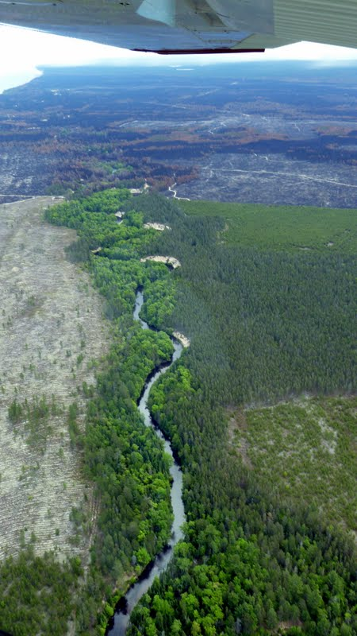
Goals
Gain a science-based understanding of current and future fire risks to forest resources and livelihoods
Hypothesize what we need to do in order to pro-actively protect/conserve the things we care about
Build & strengthen relationships with science & implementation partners
Two Hearted River Flyover, just after Duck Lake Fire

Slide 3
Approach
Assemble existing data on historic patterns, fire regimes, vegetation conditions, etc.
Literature review to understand how climate change, especially changes in the frequency and intensity of drought, are changing fire weather, fire frequency, fire intensities, and fire impacts.
Develop hypotheses of change that articulate key drivers that can be targeted with strategies
Assemble scientific evidence and gaps associated with various hypothesized drivers

Slide 4
Historical Fire Regimes
~1.2 million acres burned on average in the Northwoods annually
Most fires were relatively benign, killing < 25% of the vegetation
Fires were largely in Pine-Oak dominated ecosystems, with a substantial amount in peatlands (~65k acres)
Most ignitions were likely the result of Indigenous management

Slide 5
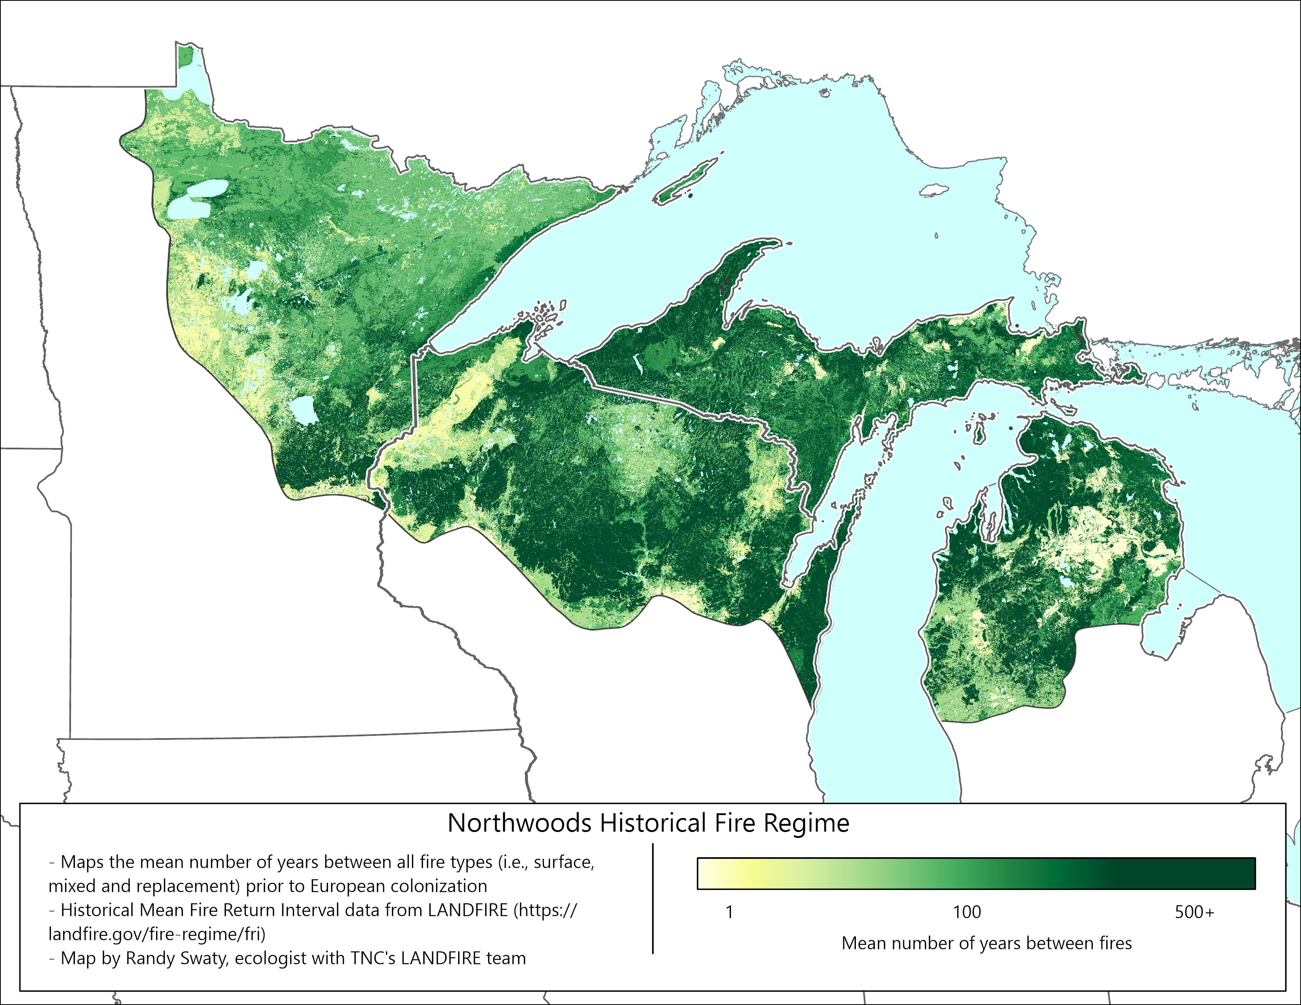

Slide 6
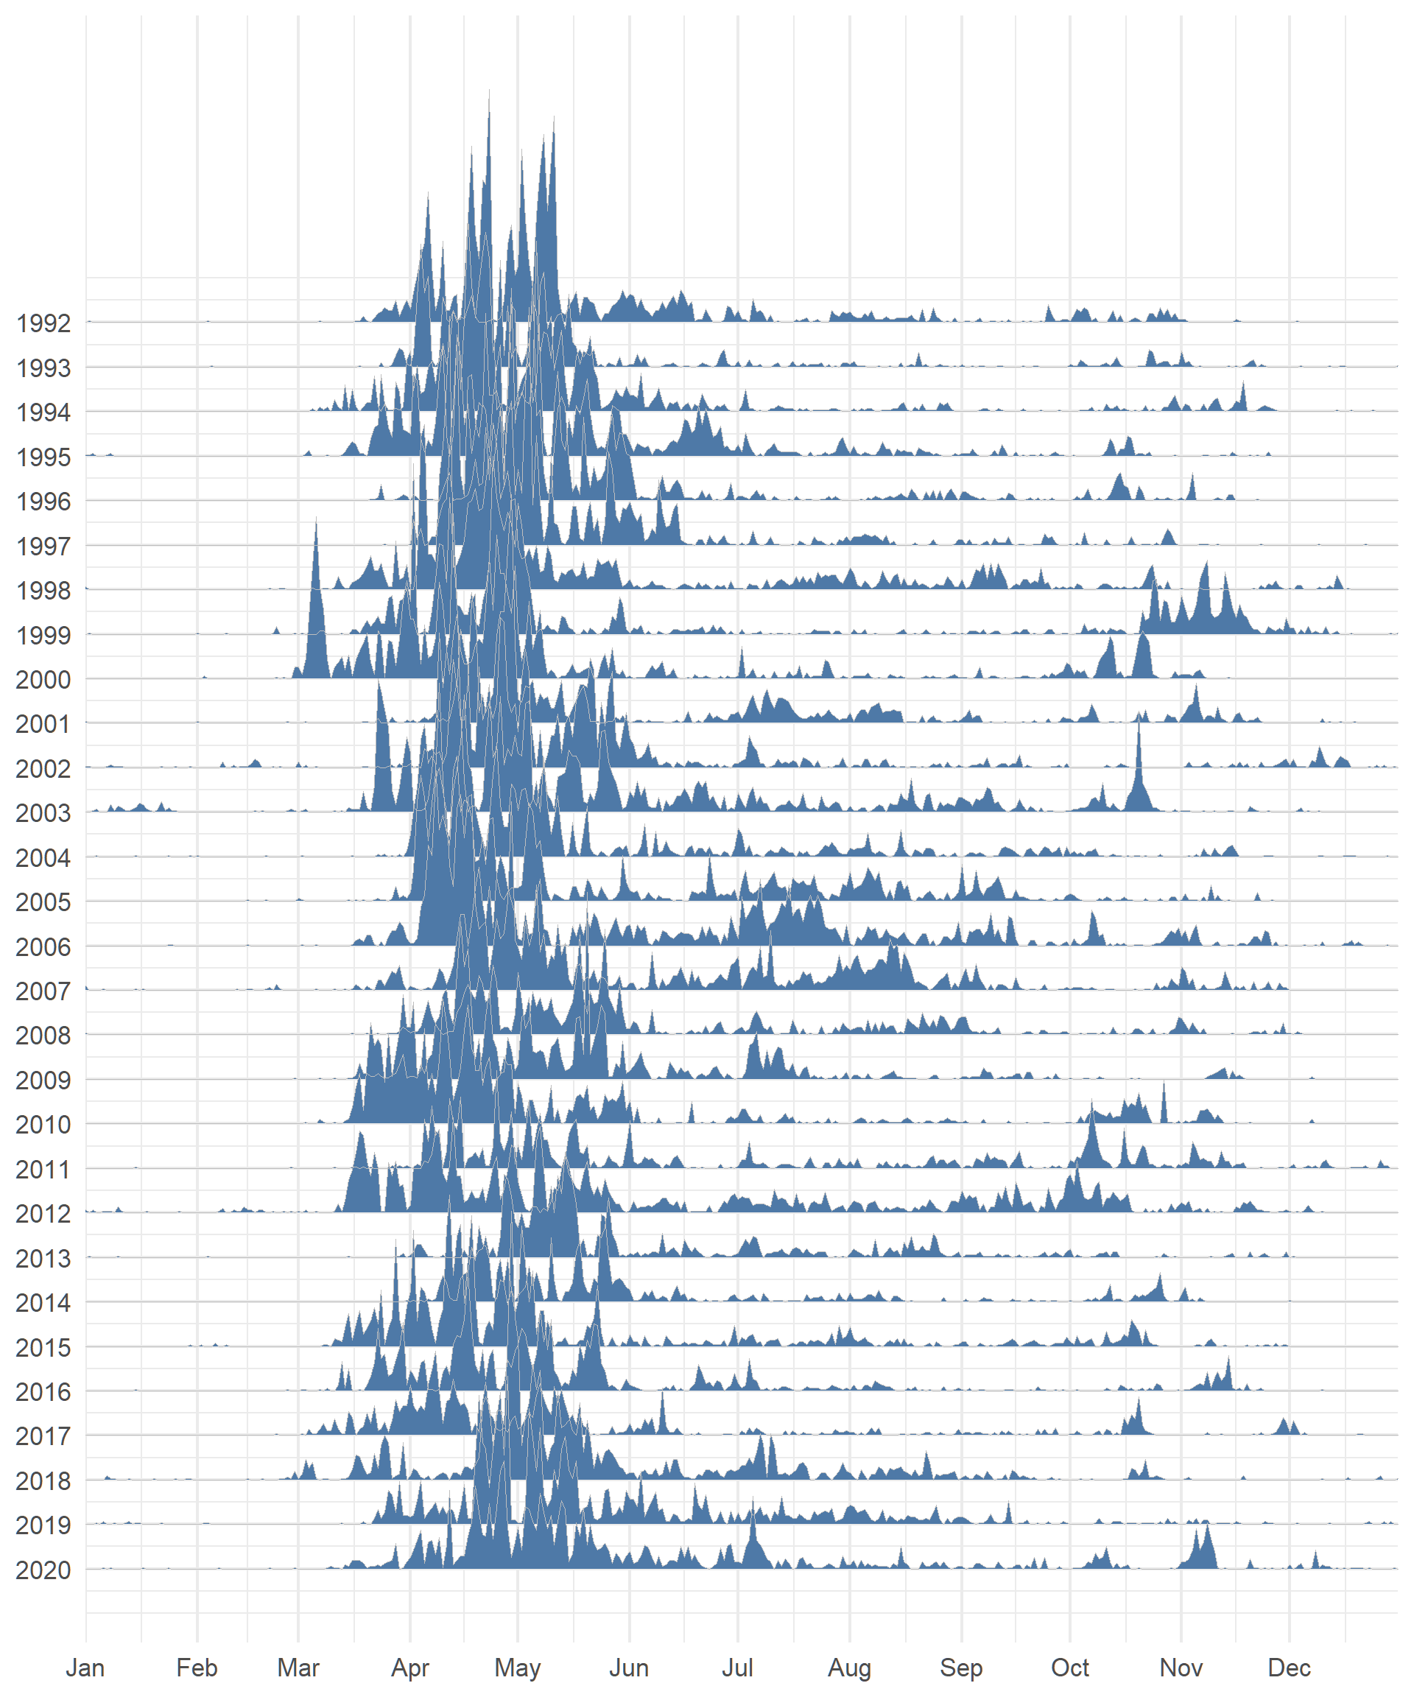
Recent Fires 1992-2020
Ridgeline height represents number of fires
~74k fires were reported with a mean of ~2,500 per year
Almost all fires are small, less than 100 ac
Duck Lake fire was the largest at ~22k acres
Most fires occur in April-May

Slide 7
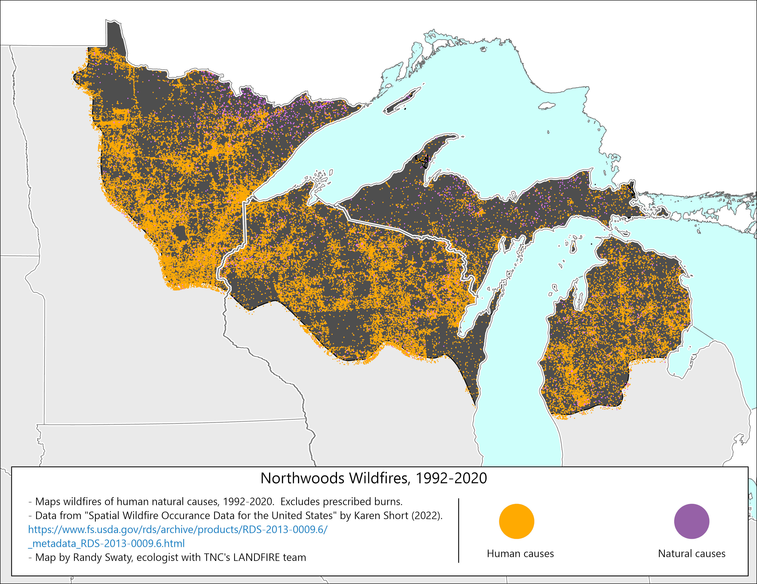

Slide 8
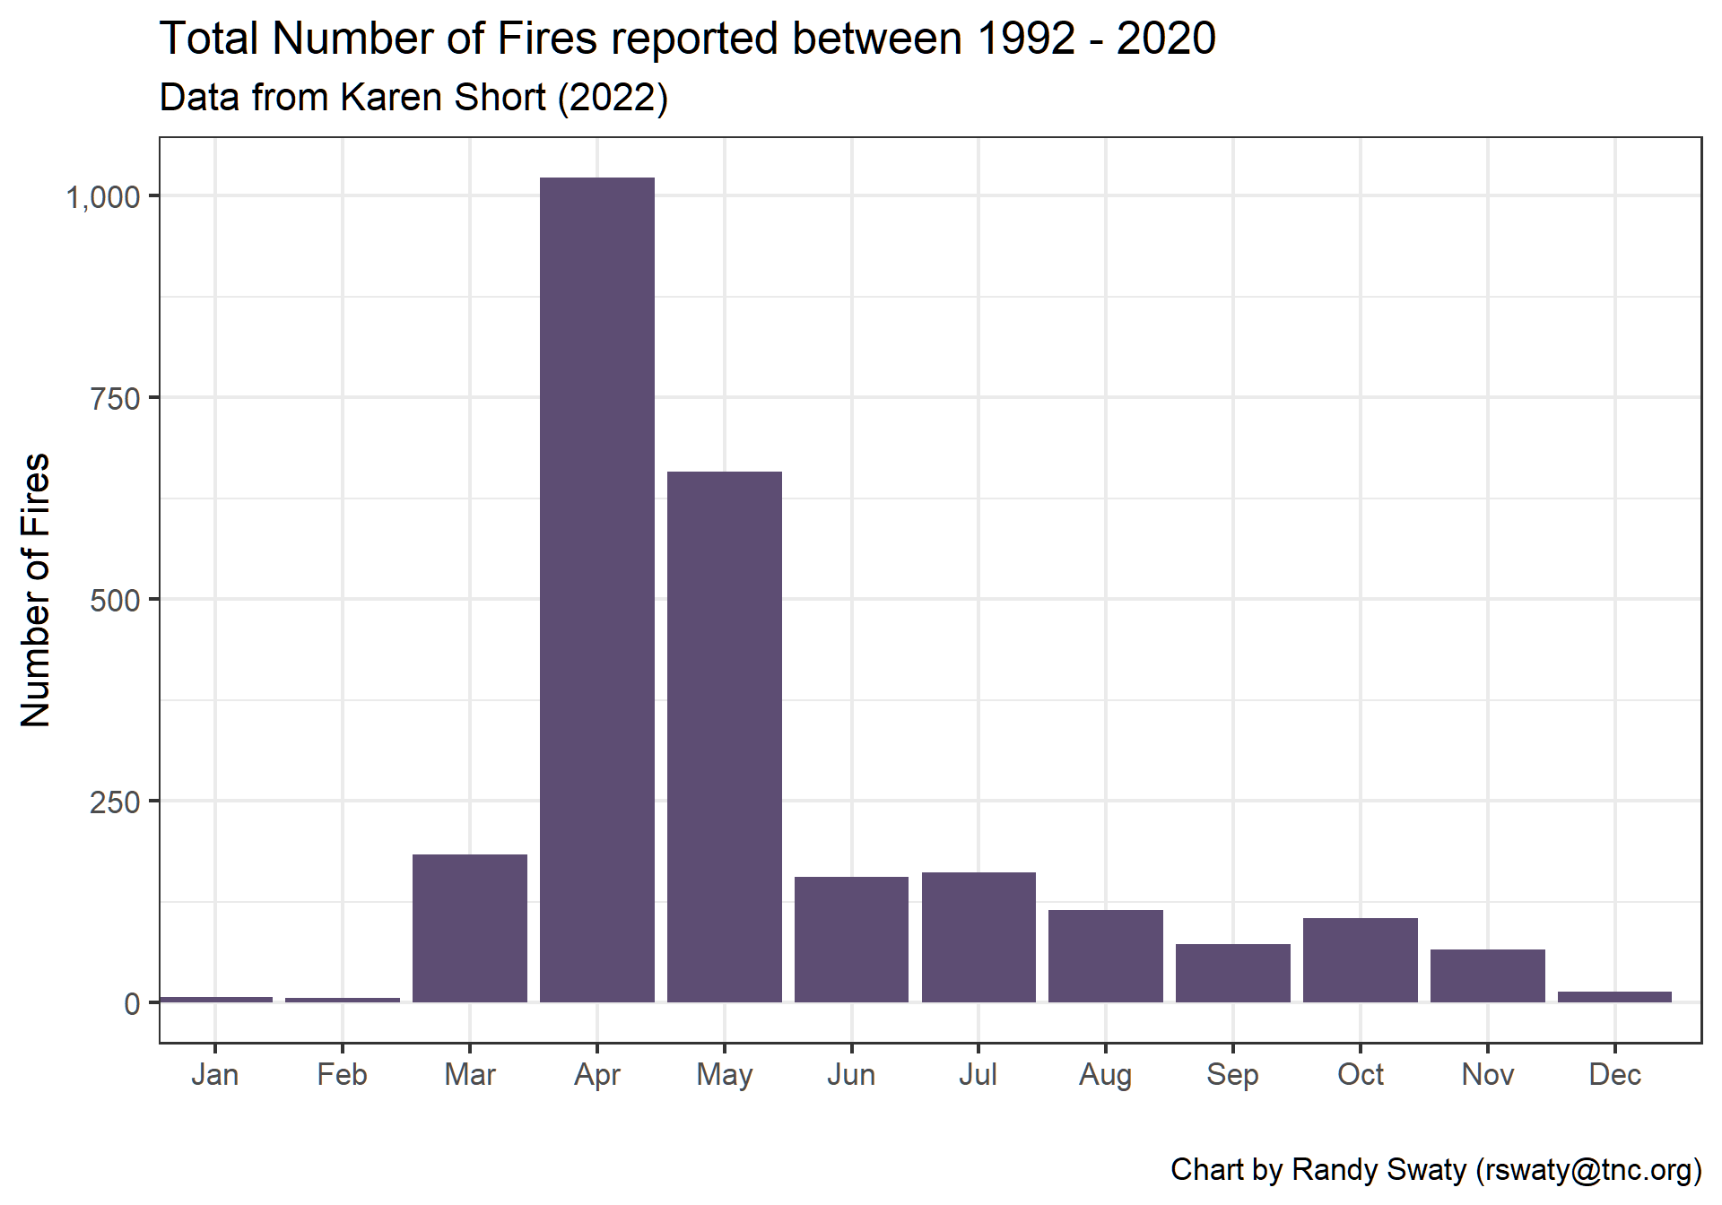

Slide 9
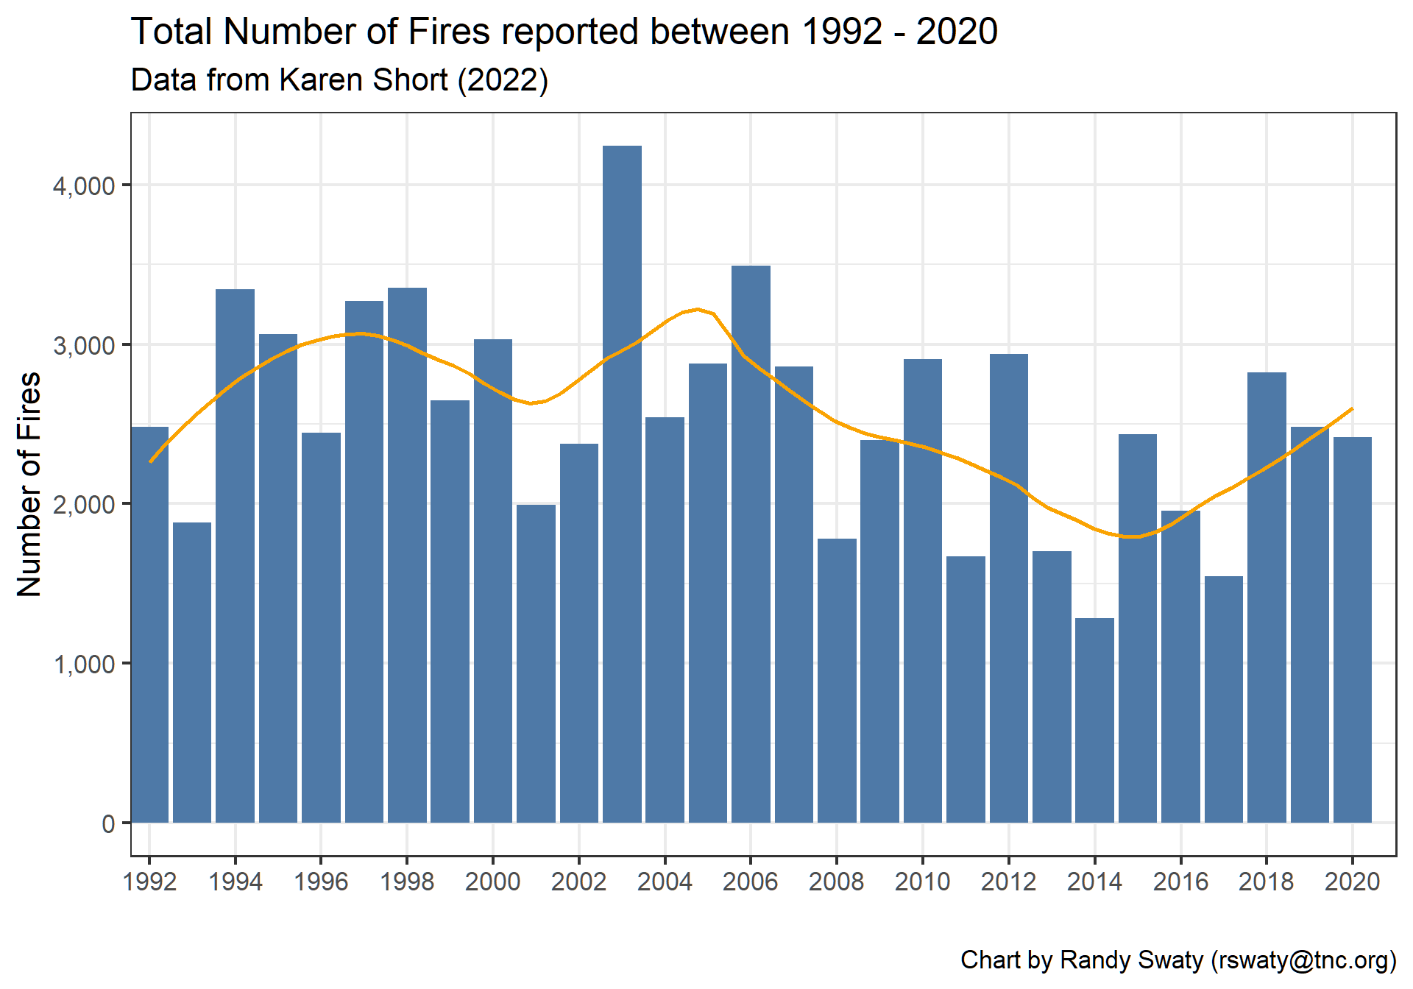

Slide 10
Wildfire Risk
While most of the Northwoods currently has relatively low risk of wildfires, there are substantial areas with moderate to high risk
When looking across multiple datasets these areas are illuminated:
Arrowhead region of MN
North central MI
North central WI
There are many smaller areas that are highlighted as well

Slide 11
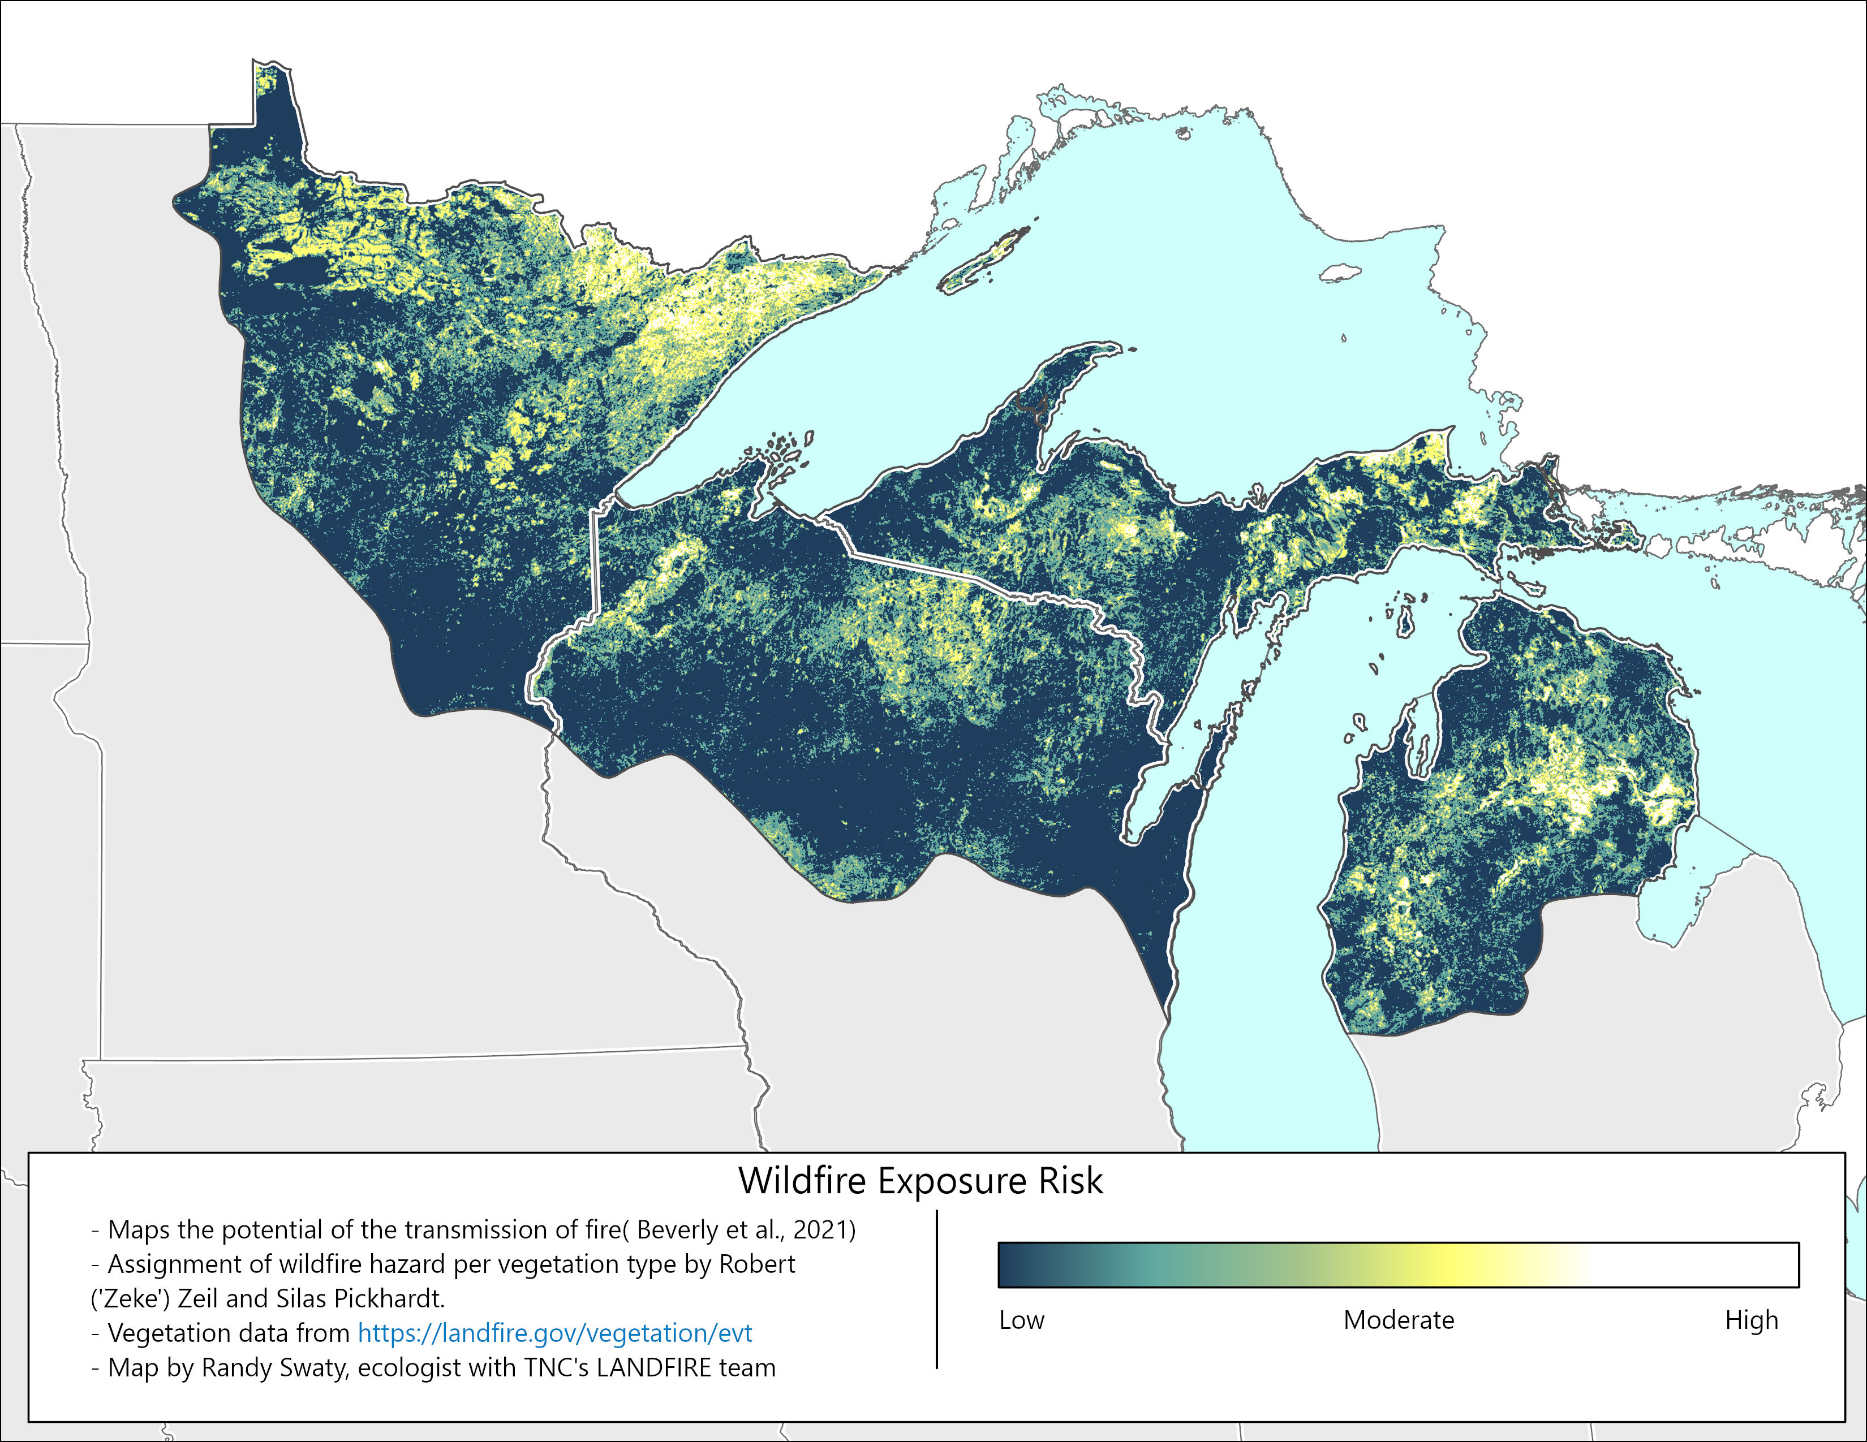

Slide 12
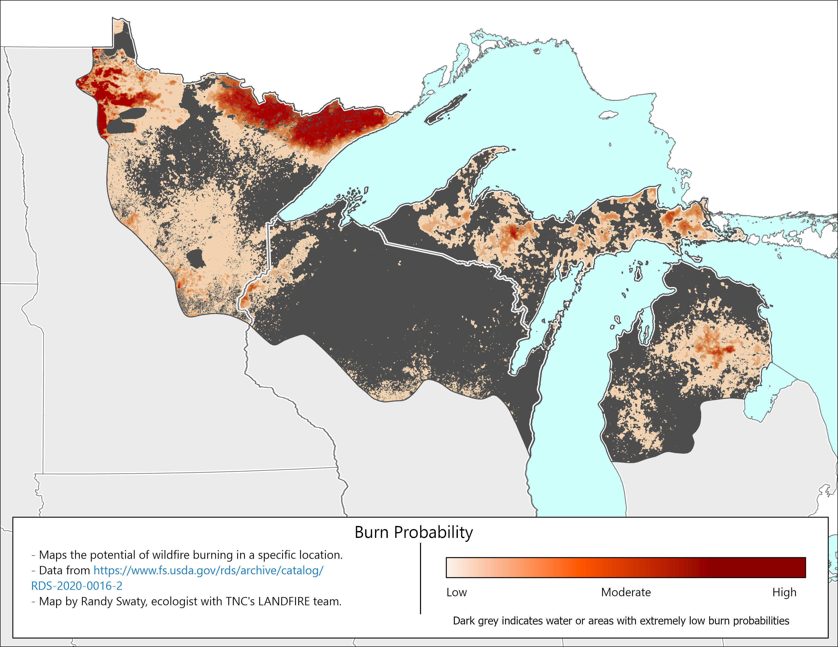

Slide 13
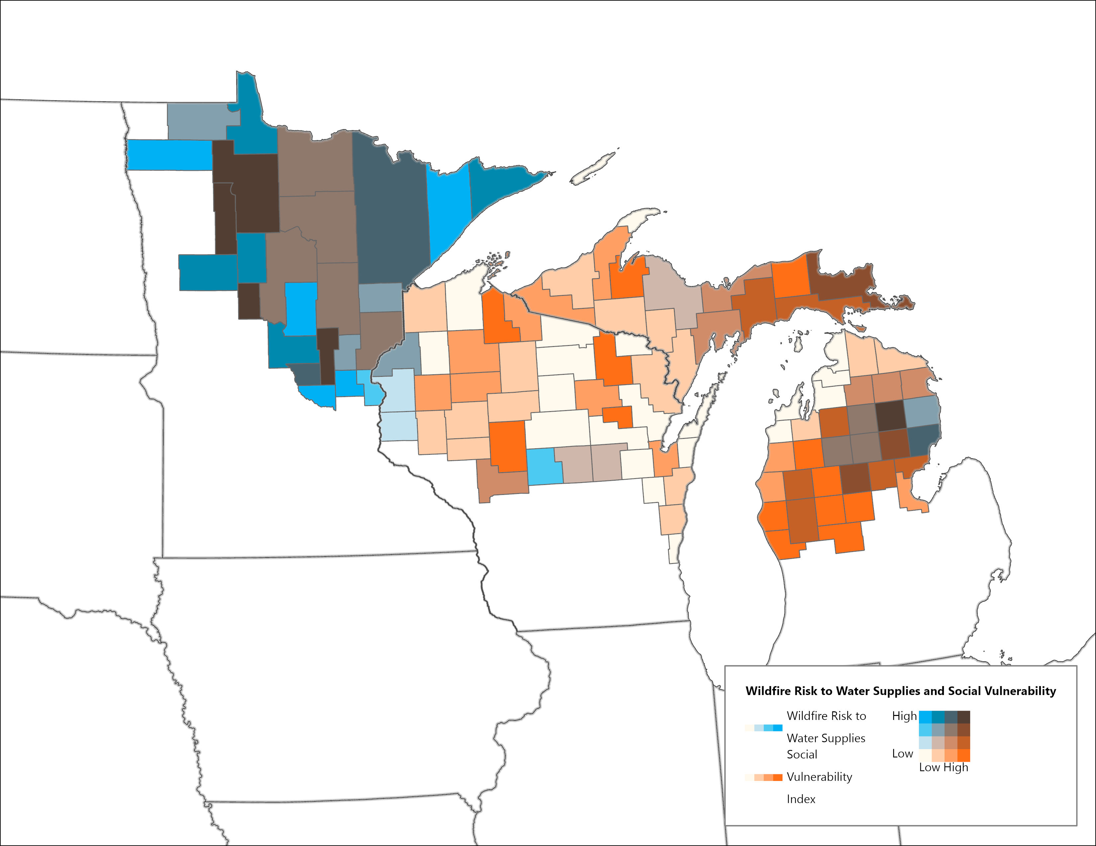
Looking forward
Populating a Mural Board with hypotheses of change, to later link (in partnership with broader group of staff) with possible strategies for dominant ecosystems
Assemble literature review products to align with these hypotheses of change.
Remap wildfire risk with future looking assumptions
Exploring connections to key conservation values (ecological, social)
Set the stage for development and implementation of multiple pilot projects
Draft map connecting wildfire risk to water supplies and vulnerable populations

Slide 14
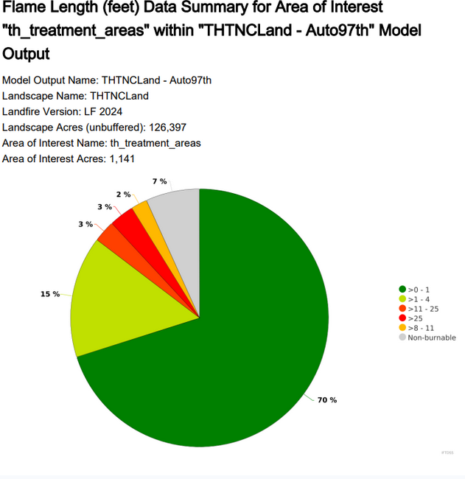
Fire Behavior Modeling in the Two Hearted
Willow Zapata of Northern Michigan University and the Conservation Data Lab is modeling potential fire behavior
Using multiple management scenarios for testing
In collaboration with Alex Hellman

Slide 15
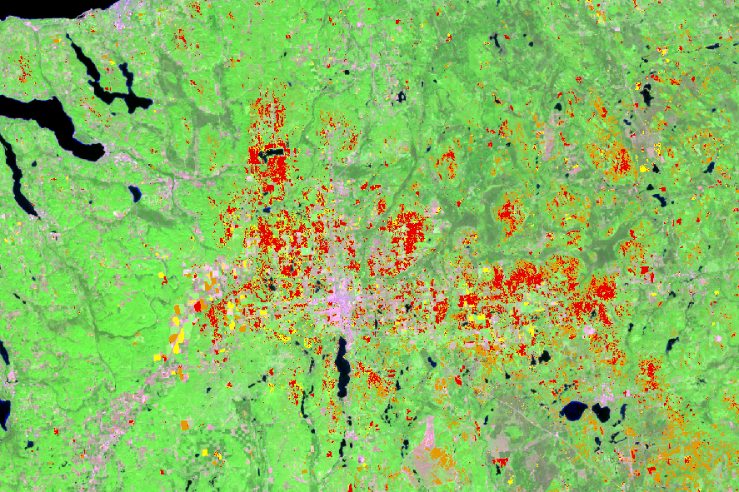
Collaborating with Sault Tribe and U of MI
Will be exploring ice storm damage mapping for the northern region of the Lower Peninsula of MI
Working to assess data quality and folding together multi-scaled datasets

Slide 16
Slate River Modeling
Collaborating with U of WI PhD and Conservation Data Lab mentor Garrett Knowlton
Exploring combined impacts of insects, fire, and climate change on forests of western MI with a pilot focus site at Slate River
Will likely make field visits to study fire history there
Modeling will inform Northwoods wide wildfire risk mapping

Slide 17
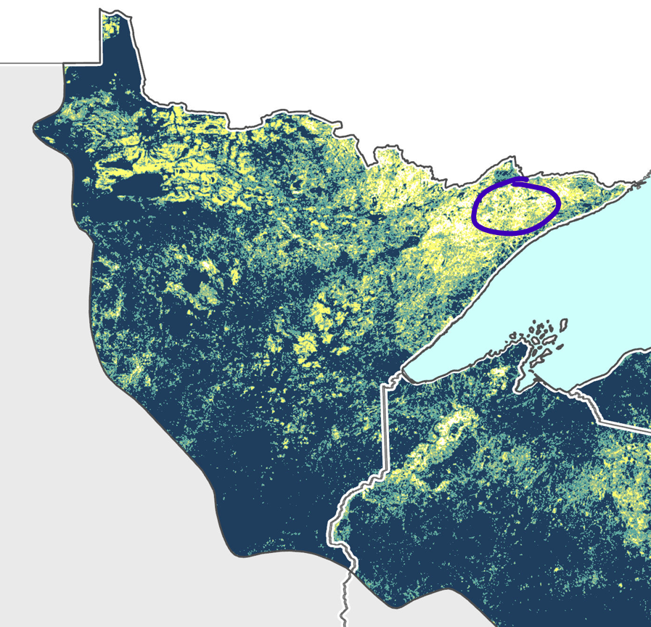
Fire treatment modeling, NE MN
Will collaborate with students and Kes Ebb (MNBU) to model potential fire behavior under various treatment scenarios
Developing app to collect community-level information

Slide 18
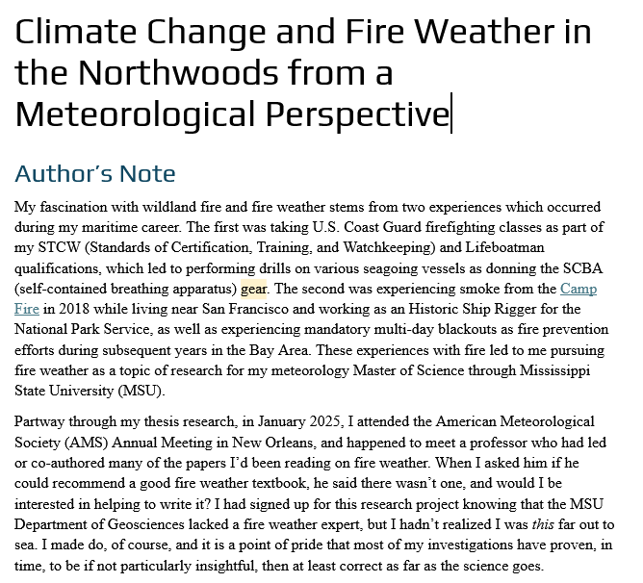
Understanding Fire Weather
Fire Weather greatly influences:
Fire behavior
Fire suppression and prescribed fire decisions
LANDFIRE has supported Meteorologist Rebecca Economides to help us understand the basics and how they might influence our work
Report almost completed

Slide 19
Summary
Whether looking at pre–European Settlement, recent past or at current wildfire risk models, it is clear that fire was and is a component of the Northwoods
There is a high probability that wildfire risk will increase and increasingly intersect with conservation values. By combining multiple lines of evidence and enabling broader conversations, we can be more pro-active in addressing this challenge.
Building community while assembling evidence is likely to help us move forward on implementation

